Slide 1
Mar 653: marketing analytics hw #1
GROUP 6: TOYIN AKINYEMI, CHRIS FREDRICK, MARGUERITE GORE, RIYADH ISHMAEL

Slide 2
AGENDA
Executive Summary
Analyses Insights
3. Profiles of the Segments
4. Characteristics of Target Segment
5. Decision

Slide 3
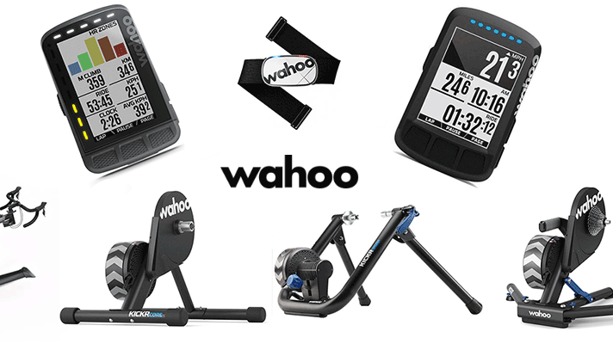
Executive summary
Recommendations
different products to hit all clusters:
Baseline (Youtube courses, customizable style options, Base app functionality)
Intermediate (includes A BATTERY THAT LASTS LONGER FOR USERS WHO WORK OUT MORE)
Top of the line (Full access app and live chat with other athletes)
Growth strategies:
Offering app to hit different segments
Providing specific deals based on what Segment you fall into
sponsorships with athletes and clubs
OFFERING AN INDOOR CYCLE BIKE ALLOWING YOU TO CYCLE / COMPETE WITH FRIENDS / FITNESS CIRCLES
ABILITY TO INTERMINGLE THE WATCHES, BIKE COMPUTER, ETC. WITH EACH PRODUCT TO MAKE SWITCHING BETWEEN EACH SEGMENT MORE ACCESSIBLE
Segment and Profiles:
Leisure - Middle sample
Intermediate - Largest sample
Competitive - Smallest samplE
Notes:
We were thinking of having Different products for each cluster

Slide 4
ANALYSES INSIGHTS
The K-means algorithm produced 3 clusters based on the survey and demographic data. We renamed these clusters based on common characteristics.
Leisure:
Users in this cohort tend to participate in their sport when they have free time. They are mostly participating for entertainment purposes.
Intermediate:
Users in this cluster aren’t super competitive but are more serious than the leisure cohort.
144 Total
276 Total
Competitive:
Users in this cluster tend to take their sport more seriously. They are focused on improving performance and therefore invest in training and products that track their activity.
93 Total

Slide 5
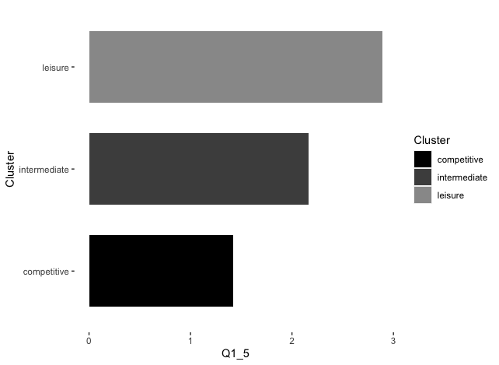
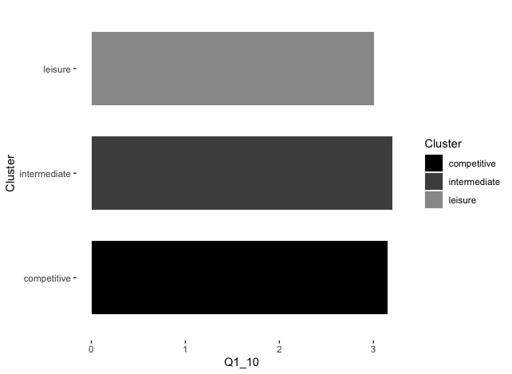
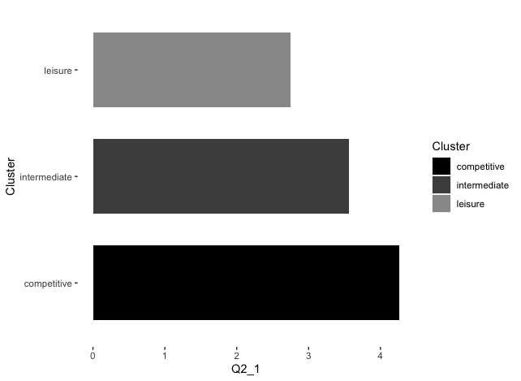
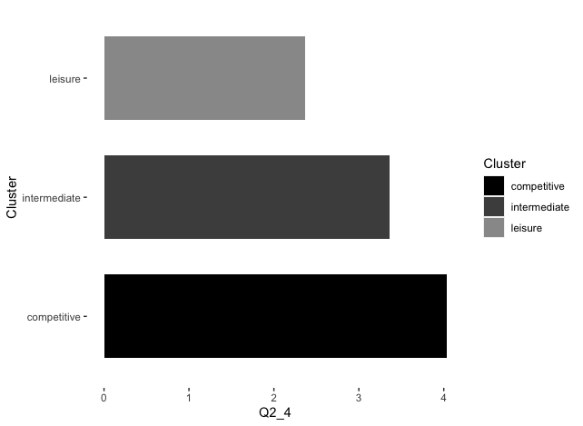
Profiles of the segments
Below are a few examples of why we named the groups the way we did based on responses to survey questions. For Q1, the lower the average score, the more the group agrees with the first statement Vs. The second. For Q2, the higher the average score, the more people agree with the statement presented.
Q1_10- I don’t have enough time for my sport activity / training Vs. I make time to pursue my sport activity / training
Q1_5 - Improving my performance is important to me Vs. Enjoying my activity is important to me
​
Q2_1 - I manage my recovery time and sleep to improve sport performance
Q2_4 - I follow a structured training plan to improve my performance

Slide 6
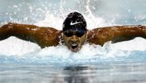
CHARACTERISTICS OF TARGET SEGMENT
Demographic Characteristics (Age and Gender):
The range of age surveyed was from 30-65. year older
80% of the Leisure and Competitive cluster were made up by male
89% of Intermediate were male
Fitness Preferences:
Leisure - Minimal fitness activity
Intermediate – Intermediate Fitness Activity
Competitive – Professional Fitness Activity
Budget:
Leisure - 63% of cluster 1 spends more than $2,000 on fitness
Intermediate - 70% of cluster 2 spends more than $2,000 on fitness
Competitive -68% of cluster 3 spends more than $2,000 on fitness

Slide 7
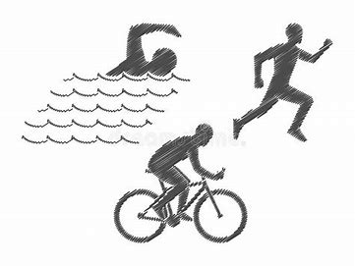
decision
Recommendation for Wahoo’s Growth:
We would recommend Wahoo to continue to find a way to integrate their products to other fitness technology products that will lead the company to growth.
Suggestions for Targeting for Growth, New Products or New Features:
For targeting growth for Leisure (Cluster 1) we suggest that Wahoo could explore doing a partnership with hotel gyms and university gyms to add Wahoo products to their space
We recommend for Wahoo to continue to focus on the Intermediate group (Cluster 2), for growth. This group resonates with Wahoo products the most. Wahoo could target this market more by running ads on sport channels (CBS, Fox, ABC, ESPN ,TNT, and others) that are playing a game
Another big opportunity for Wahoo is to partner with Tokyo, TSC London, NYC, and Boston. Wahoo would sponsor the event and would provide their runners with their products to help train for the marathon and make it a requirement for all athletes to wear it during the race
Wahoo would have a new upcoming athletes be the face of their brand
Having live fitness classes

Slide 8

Thank you!

Slide 9
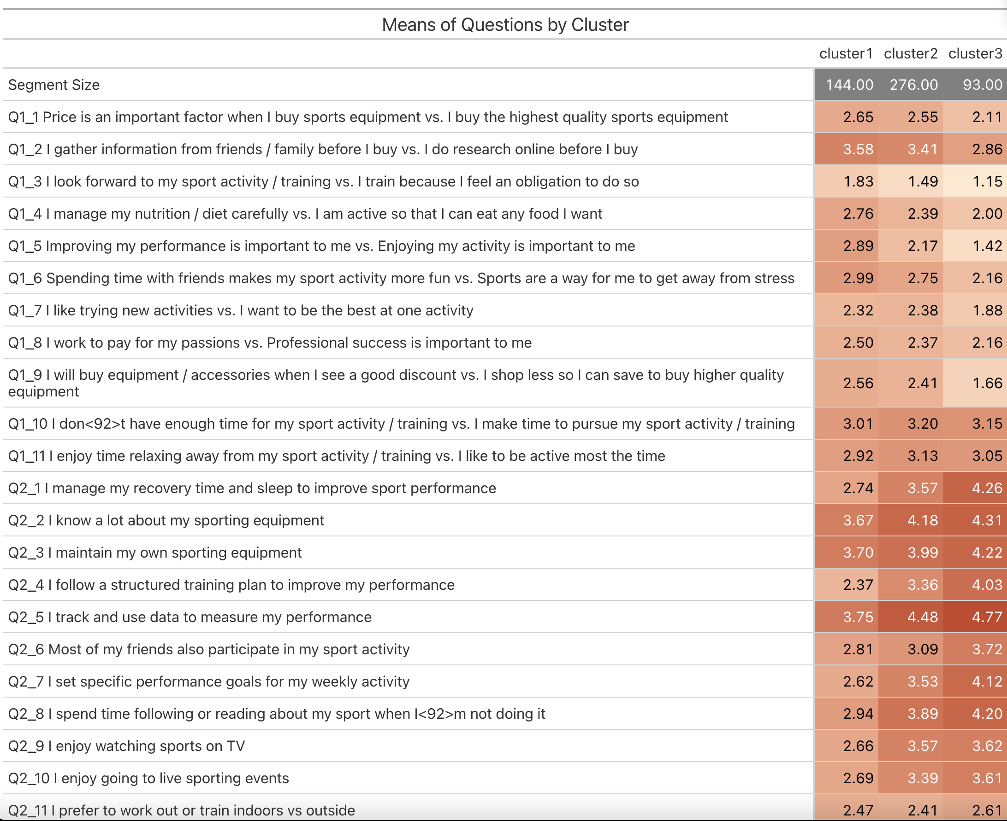
APPENDIX SLIDES

Slide 10
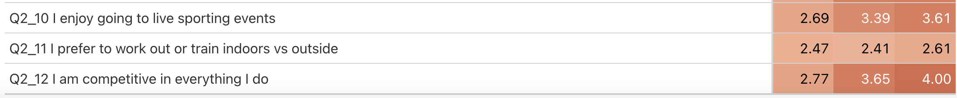
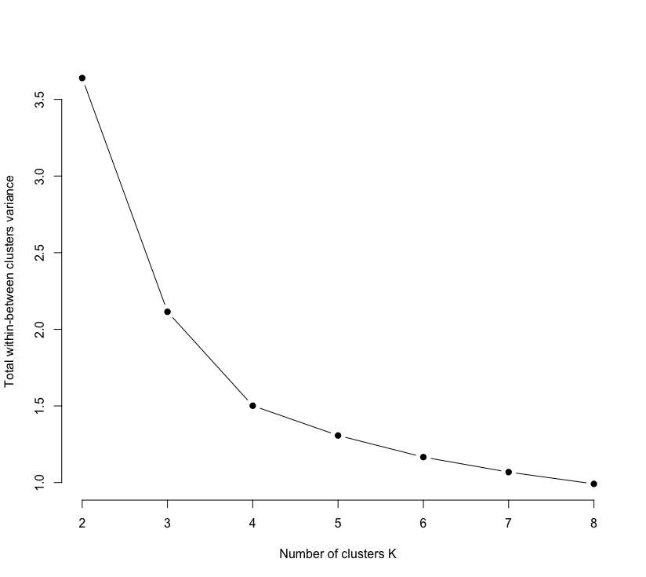

Slide 11
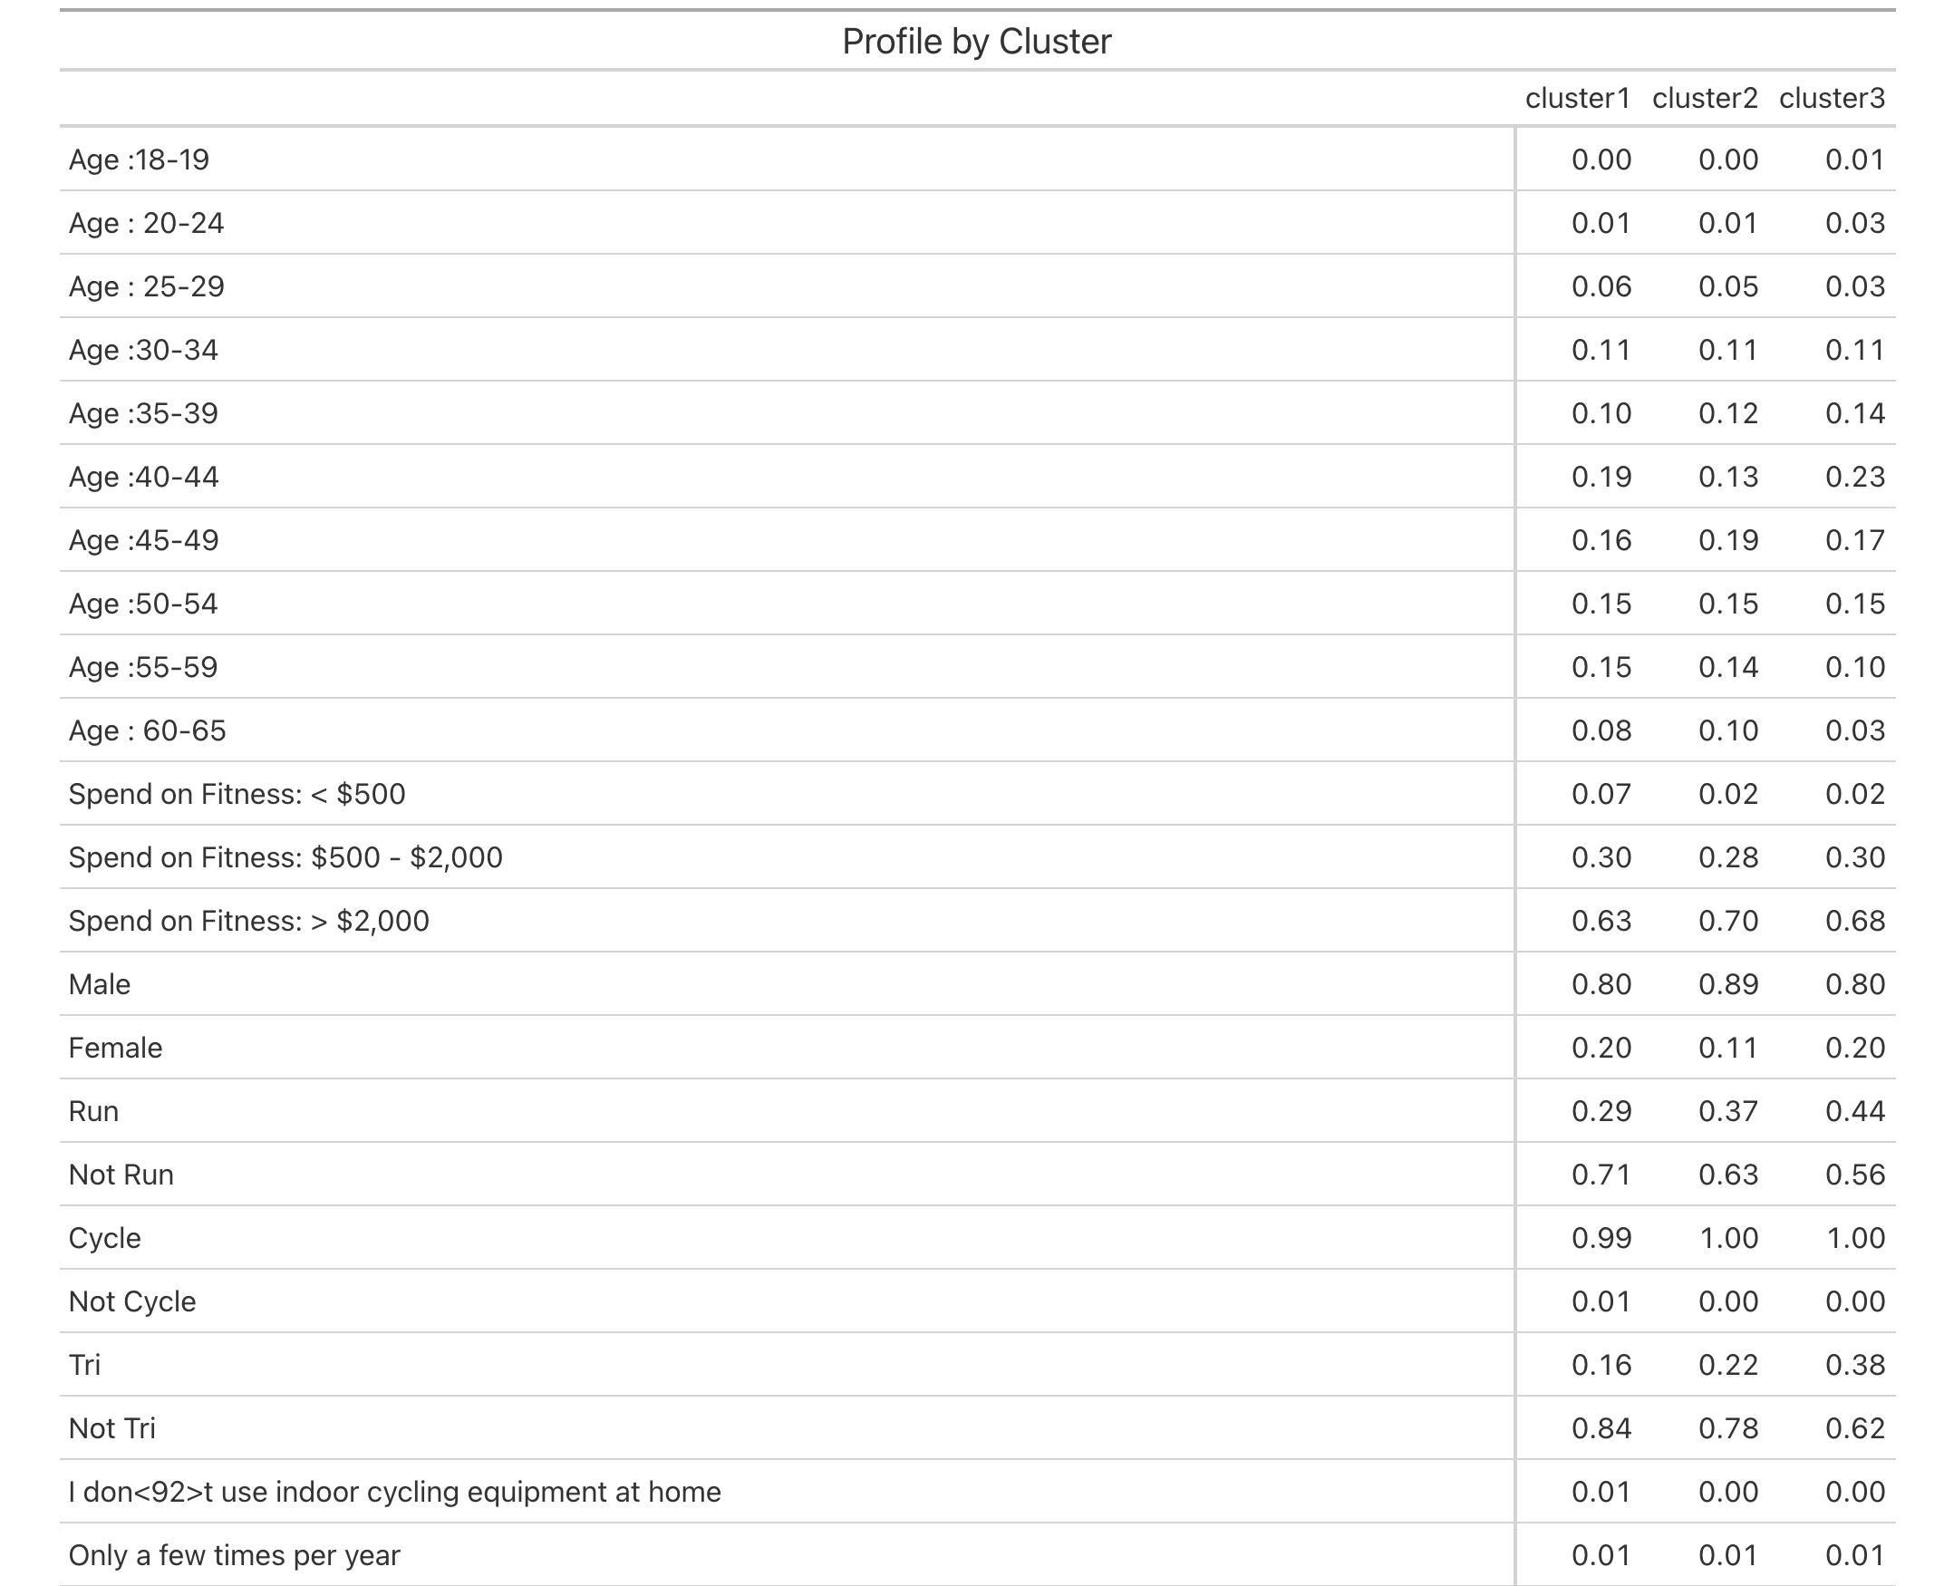

Slide 12
